Slide 1
Red Shifting 3D Graphics Project
My first REAL presentation for presentation night!

Slide 2
What is Red Shifting?

Slide 3
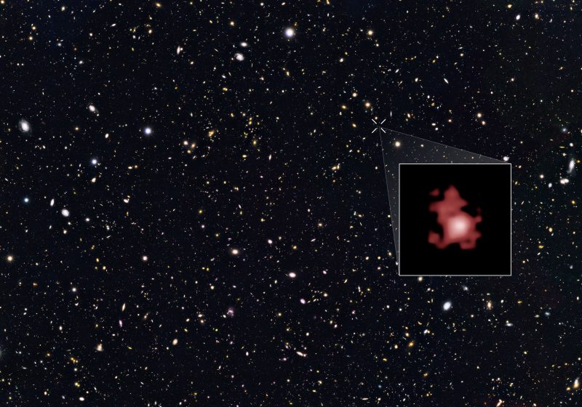
In our universe, galaxies and stars moving away from us appear redder. Why?

Slide 4
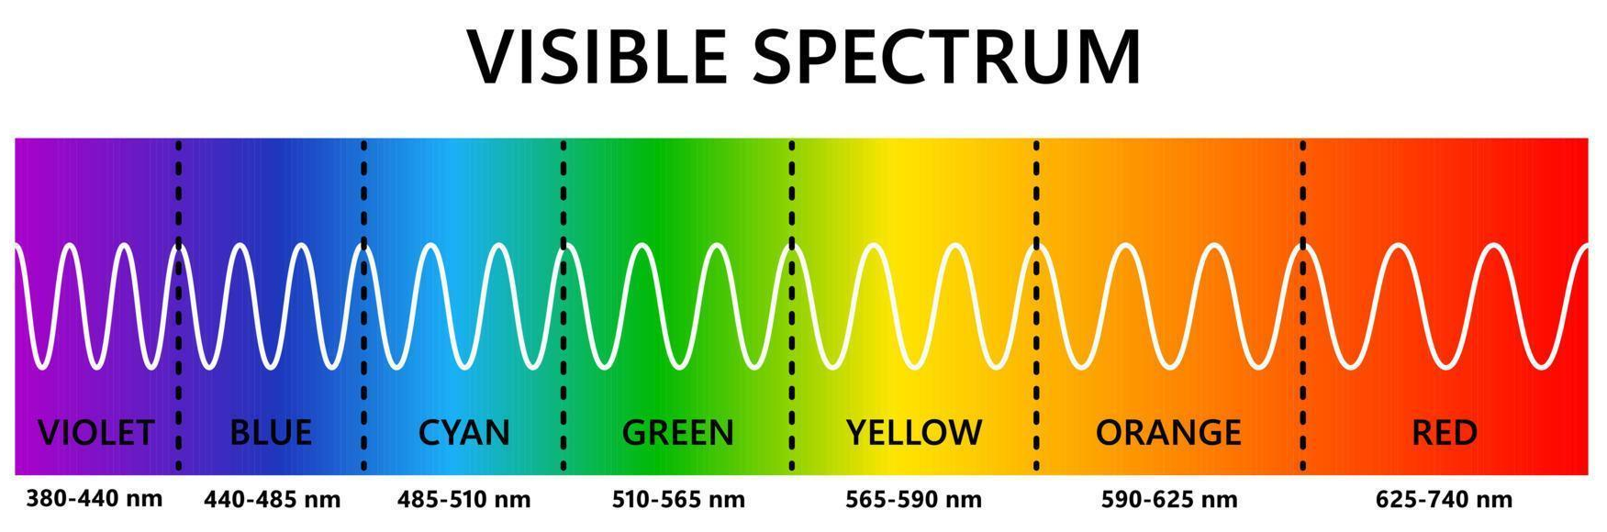
Light as a Wave

Slide 5
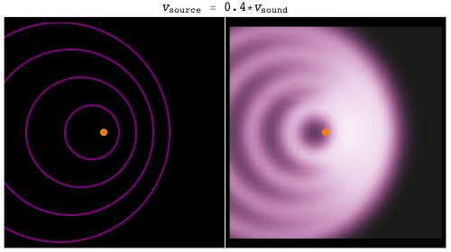
The Doppler Effect

Slide 6
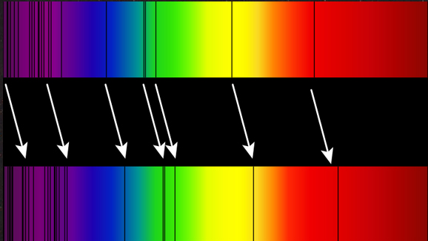
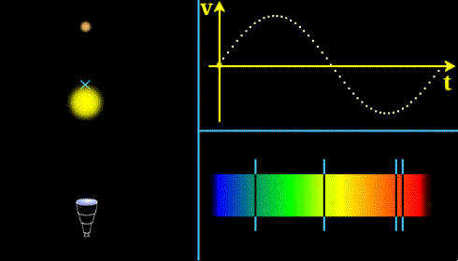
Doppler Effect on Light Waves
As an object emitting light moves away from our eyes, the light wave stretches, moving more toward red
Graphic of light waves expanding and contracting in a two body system

Slide 7
Perceiving Color

Slide 8
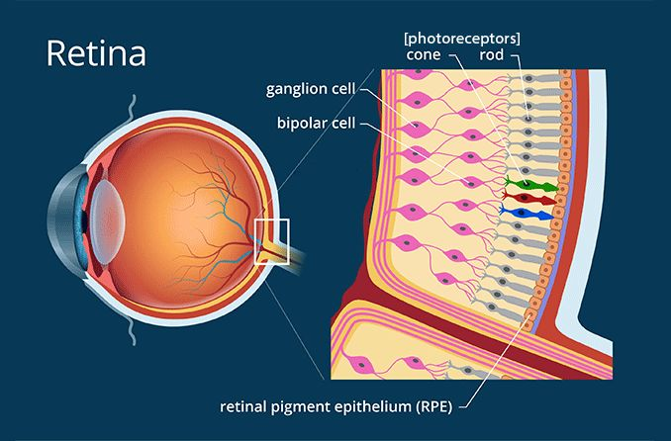
How the Human Eye Perceives Color - Cones
Our eyes comprise of cones and rods. Rods perceive light intensity, Cones perceive color
Three types of Cones:
S Cones (Sensitive to small wavelengths, such as blue)
M Cones (Sensitive to medium wavelengths, such as green)
L Cones (Sensitive to large wavelengths, such as red)

Slide 9
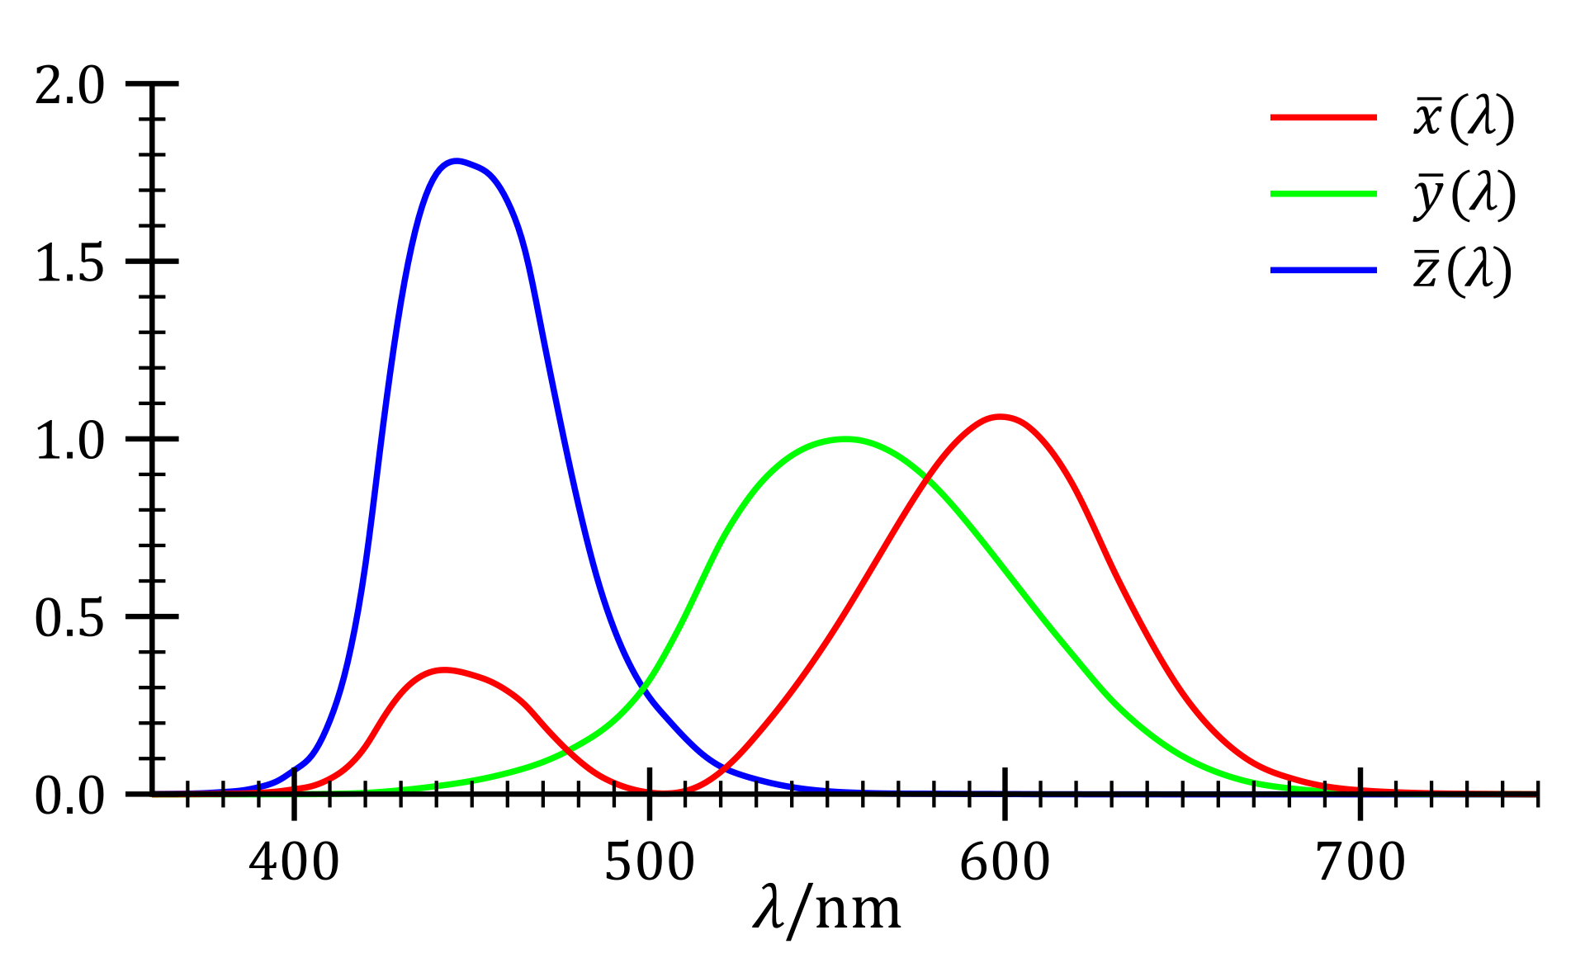
How the Human Eye Perceives Color - Cones
Given a light wave with a certain wavelength. The following graph describes how sensitive our S, M and L cones are to that certain wavelength

Slide 10
Color Matching - One Wavelength
?

Slide 11
Color Matching - Two Wavelengths
?

Slide 12
Color Matching - Three Wavelengths
?

Slide 13
Color Matching - INFINITE WAVELENGTHS
S(𝜆)
¯\_(ツ)_/¯
Objects that emit light more oftenly emit a whole spectrum of light waves
This curve can be thought of as “at some wavelength, how intense is our light?”
Ok so uh… how do we figure out what color this is??

Slide 14
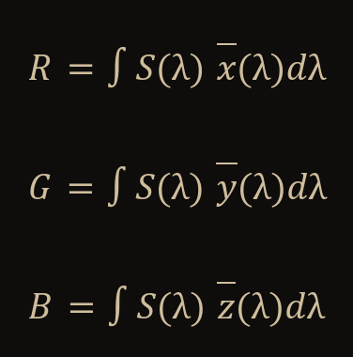
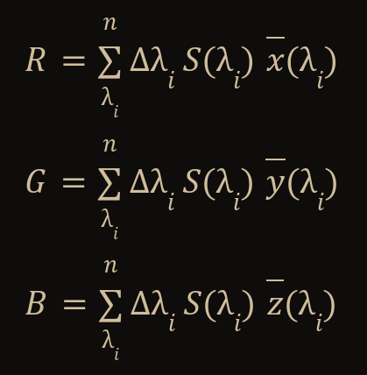
Color Matching - INFINITE WAVELENGTHS
S(𝜆)
Infinite case
discrete case
R is how “red” our spectral power distribution is
G is how “green” our spectral power distribution is
B is how “blue” our spectral power distribution is

Slide 15
Color Matching - INFINITE WAVELENGTHS
?
S(𝜆)

Slide 16
Computers and Color

Slide 17
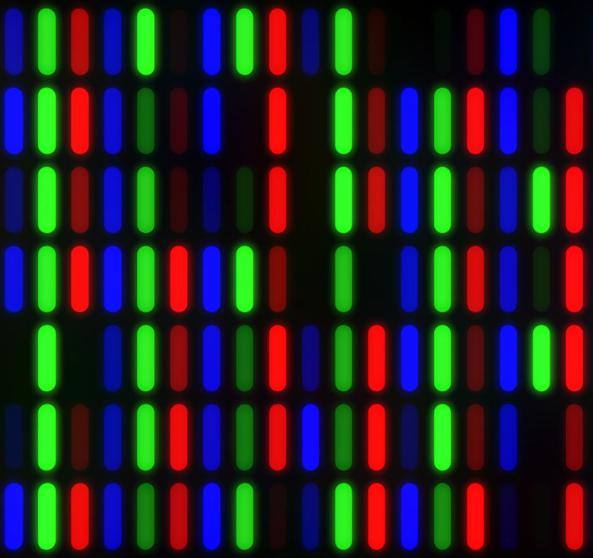
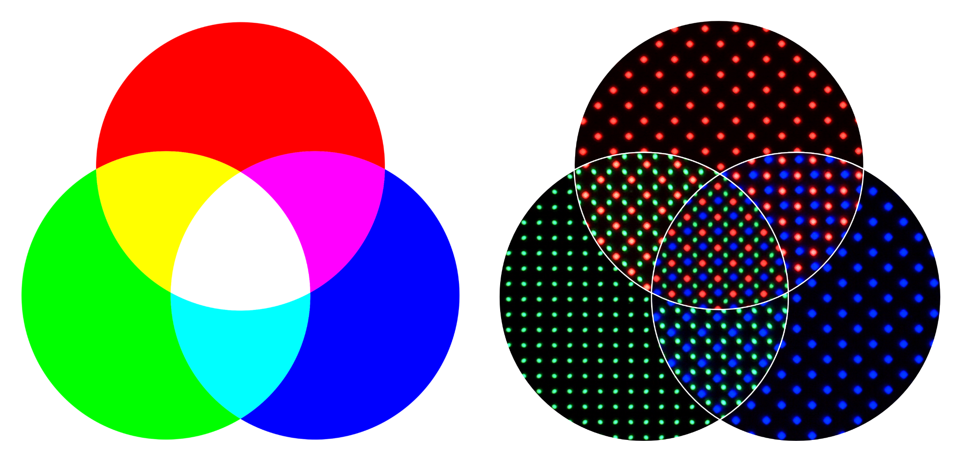
Pixels
1 pixel!
Example of pixels projecting various colors
Every color on a screen is some combination of red, green, and blue. Pixel colors are represented as (r, g, b)

Slide 18
Redshifting an Image

Slide 19
What We Want
S(𝜆)
S(𝜆+Δ𝜆)
Spectral Power Distribution before redshift
Spectral Power Distribution after redshift

Slide 20
Step 1 - Get Wavelengths from RGB Color
We are given R, G, and B, how can we get the family of light waves?
There’s an infinite number of possible families we can choose from, so let’s choose the easiest to work with!
Lb = (λb,Ib)
Lg = (λg,Ig)
Lr = (λr,Ir)
I’ve picked these 3 light waves as our family

Slide 21
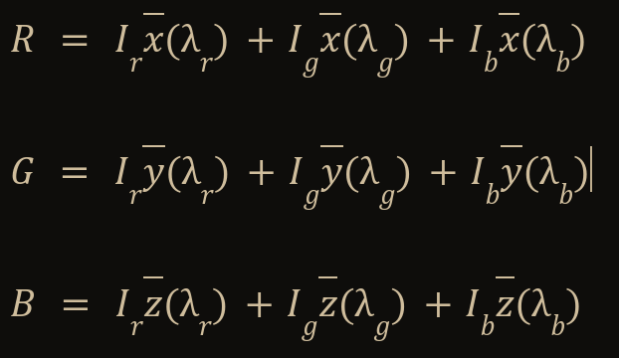
Step 2 - Get Light Wave Intensities
Let I_{r}, I_{g}, I_{b} be the intensities of our chosen light waves
Let λ_{r}, λ_{g}, λ_{b} be the wavelengths of our chosen light waves
Lb = (λb,Ib)
Lg = (λg,Ig)
Lr = (λr,Ir)

Slide 22
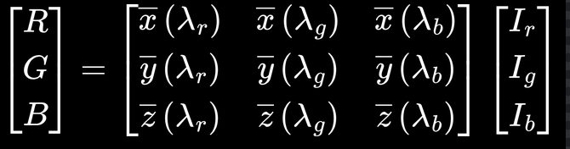
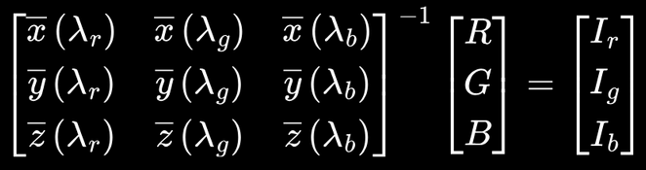
Step 2 - Get Light Wave Intensities: Matrix Math
Hey this is a system of equations! We can solve this using a matrix!

Slide 23
Step 3 - Change The Wavelength!
λ_{r}, λ_{g}, λ_{b} are our light wavelengths.
We’re redshifting this! So our wavelengths are gonna be offset by some value!
Let Δλ be our offset.
Our new light wavelengths are: (λ_{r}+Δλ), (λ_{g}+Δλ), (λ_{b}+Δλ)
Let Δλ be the offset we see in the image above

Slide 24
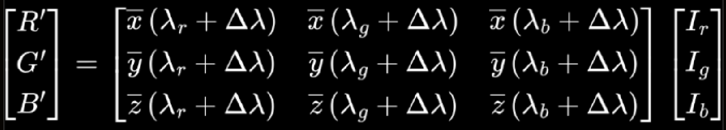
Step 4 - Make Our New Color!
We have everything we need to get our new colors!
Tada! We have red shifted our color!!

Slide 25
Live Demo!

